Slide 1
LAB – 07
Functions

Slide 2
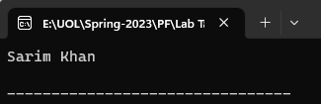
Task - 1
Write a program that contains a function which displays your name.

Slide 3
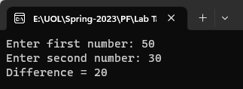
Task - 2
Write a program that contains a function which takes two numbers from user and displays their difference.

Slide 4
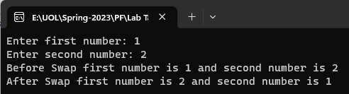
Task - 3
Write a program that inputs two integers in main ( ) and passes the integers to swap( ). The swap( ) exchanges the values.

Slide 5

Task - 4
Write a program that contains calculate_area( ) which takes radius of circle as an argument and returns area of circle to main ( ).

Slide 6

Task - 5
Write a program that contains a function which takes one integer type of argument and returns factorial of the number.

Slide 7
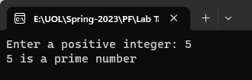
Task - 6
Write a program that contains a function which takes one integer type of argument and confirm that number is prime or not.

Slide 8
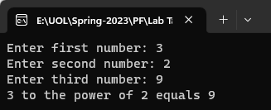
Task - 7
Write the a program using function that takes as input the three numbers. The function returns true if the first number to the power of the second number equals the third number; otherwise, it returns false.

Slide 9

Task - 8
Write the definition of a void function that takes as input a decimal number and outputs 3 times the value of the decimal number. Format your output to two decimal places.

